Slide 1







order
bom
shipment
purchase
production
warehouse
planning
END TO END TESTING

Slide 2
Week ( 2025/06/23 – 2025/06/28 ) Progress
1
Order Creation
2
Pull BOM
3
Create Collection and Run
4
Purchase Management
5
Warehouse Stock
6
Planning
7
Fetching Generation
8
Fetching Issues
9
Production
10
FG Inbound
11
Shipment

Slide 3
The Process flow of creating a sales order
Adidas Team Order Process
The Adidas team places orders with our organization on a monthly basis, and modifications to these orders are made weekly as needed.
Orders are submitted in a structured format that includes:
PO , CRD , ARTICLE , ORDER QUANTITY
Start
Orders From Adidas
Sales Order Creation Process
The Order Team is responsible for managing customer orders received through the Infor Nexus system. The process involves downloading the orders and creating or updating sales orders in the SAP system
Download Order from Infor Nexus
Create Sales Order
VA01
Standard SAP transaction code used to create new sales orders.
ZSD001N
VA01
VA02
Standard SAP transaction code used to modify or update existing sales orders.
Update
VA02
ZSD001N
A customized transaction code developed to facilitate bulk order uploads efficiently.
Clarification on the Use of VA01 Despite the Availability of ZSD001N ( Earlier-discussed )
While ZSD001N improves efficiency for bulk uploads, VA01 remains essential in scenarios where:
Manual intervention or case-by-case entry is needed.
Quick correction or validation is required before order confirmation.
Orders are not suitable for the bulk upload format.
End

Slide 4
The Process For Pull BOM Data
Process for Pulling BOM Data Using T-code ZMM123
The ZMM123 transaction code is a custom SAP T-code used to pull Bill of Materials (BOM) data for material planning and execution processes.
Start
Access SAP GUI
Log into the SAP system with the appropriate credentials.
Access SAP GUI
Navigate to T-Code ZMM123
In the command field enter ZMM123 and Press Enter.
Navigate to T-code ZMM123
Input Required Parameters
Material Number – Enter the specific material or article number.
Plant Code – Specify the plant for which the BOM data is required.
Other Filters (if applicable) – CRD date, PO number, or other specific criteria to narrow down results
Input Required Parameters
Execute the T-code
Execute the T-code
Click on Execute (F8) to run the process
Review the BOM Data
ZMM123
The system retrieves and displays the list of BOM components associated with the entered material.
End

Slide 5
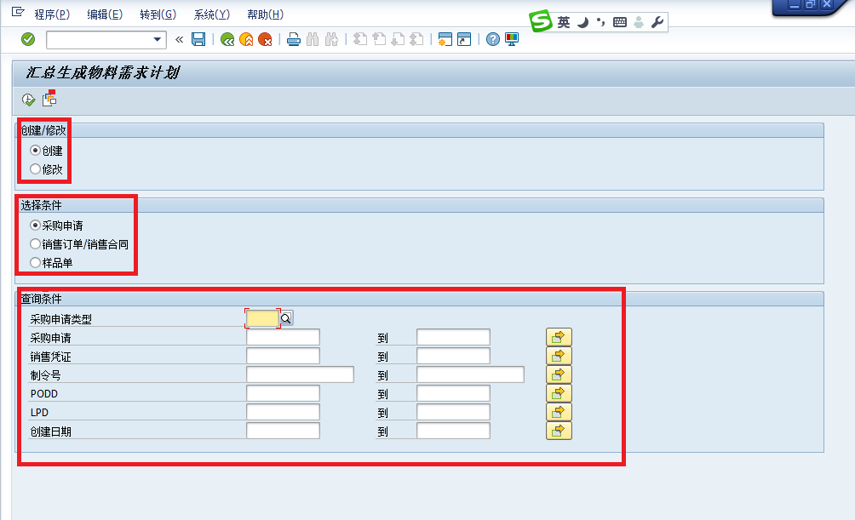
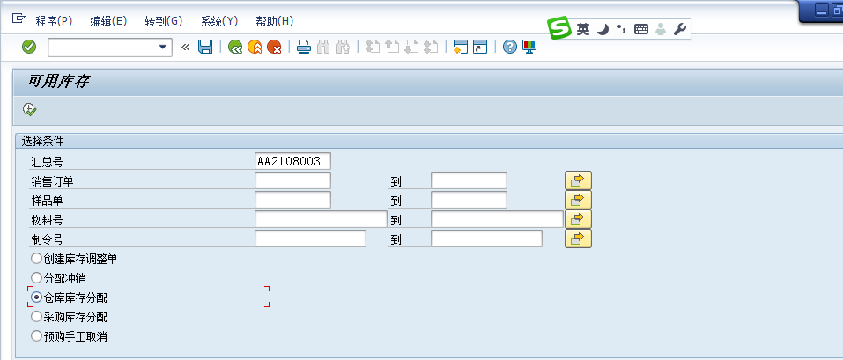
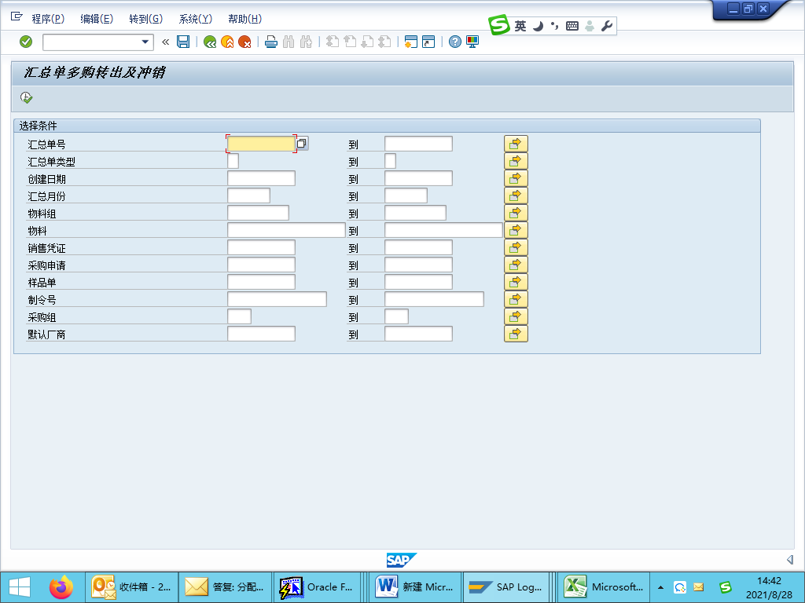
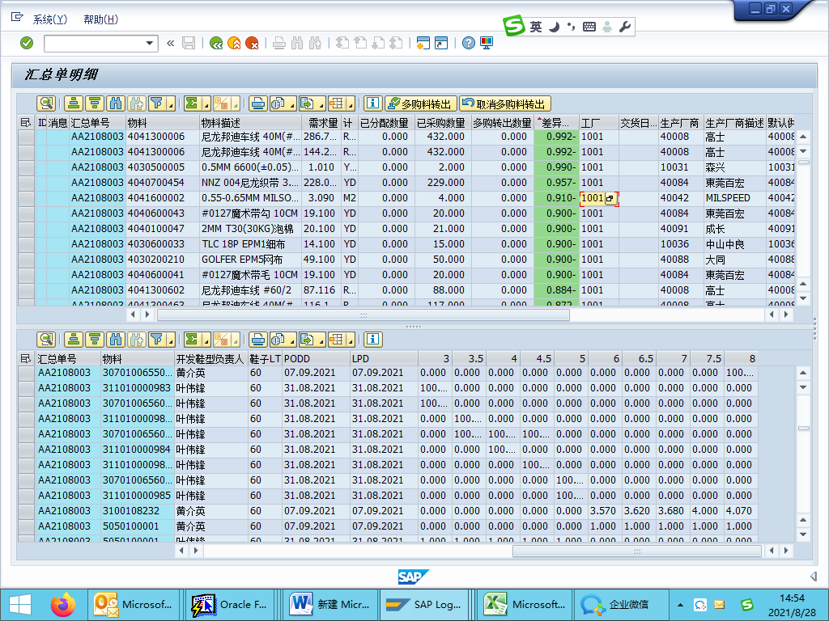
The Process of Create Collection and Run
ZMM019 – Material Order Summary Creation
Select Create Option
Choose the appropriate summary condition based on the order type:
1. Carton Box / Supplement Orders → Select Purchase Requisition
2. Mass Production Orders → Select Sales Order / Sales Contract
3. Development Orders → Select Sample Order
ZMM018 – Material Allocation Process
Warehouse Stock Allocation
Open transaction ZMM018
Enter the Summary Number
Execute
Procurement Stock Allocation
Repeat the same steps as Warehouse Stock Allocation Ensure to save after execution
ZMM017 – Excess Purchase Transfer
Open transaction ZMM017
Enter the Summary Number and Vendor Code
Once the material list appears, review the material status Based on the status :
Transfer for Excess Purchas
Cancel Excess Purchase Transfer

Slide 6
Next Week ( 2025/06/30 – 2025/07/05 ) Plan
1
Order Creation
2
Pull BOM
3
Create Collection and Run
4
Purchase Management
5
Warehouse Stock
6
Planning
7
Fetching Generation
8
Fetching Issues
9
Production
10
FG Inbound
11
Shipment

Slide 7
Placing Purchase Orders With the collection
1 . Need to check with warehouse department about stock quantity 2 . Avoid to purchase over quantity 3 . Must be clear with BOM Team
Material Received in Warehouse
Campare material availability in WMS with SAP

Slide 8



